Slide 1
Membership Overview

Slide 2
Antitrust Policy Notice
Linux Foundation meetings involve participation by industry competitors, and it is the intention of the Linux Foundation to conduct all of its activities in accordance with applicable antitrust and competition laws. It is therefore extremely important that attendees adhere to meeting agendas, and be aware of, and not participate in, any activities that are prohibited under applicable US state, federal or foreign antitrust and competition laws.
Examples of types of actions that are prohibited at Linux Foundation meetings and in connection with Linux Foundation activities are described in the Linux Foundation Antitrust Policy available at linuxfoundation.org/antitrust-policy. If you have questions about these matters, please contact your company counsel, or if you are a member of the Linux Foundation, feel free to contact Andrew Updegrove of the firm of Gesmer Updegrove LLP, which provides legal counsel to the Linux Foundation.

Slide 3


An Open Source Foundation Developed in Partnership
The Academy Software Foundation provides a neutral forum for open source software developers in the motion picture and broader media industries to share resources and collaborate on technologies for image creation, visual effects, animation and sound.
Notes:
The Academy Software Foundation was developed in a partnership between the Academy of Motion Picture Arts and Sciences and the Linux Foundation, both partners bringing a unique blend of film industry knowledge and open source technical and organizational expertise to create a unique organization dedicated to accelerate software development and innovation in the motion picture industry.

Slide 4

Why the Academy Software Foundation?
Legal Framework
Continuous Integration and Build Infrastructure
Clear path to accepting contributions (neutral forum)
Versionitis
Notes:
These were some of the problems that the Foundation set out to solve.

Slide 5


ASWF created
Open Source Forum 2022
Open Source Days 2024
01
01
First project
Open Source
Day 2019
Open Source Days 2020
Open Source Days 2021
March 10,2022
Rez
DPEL
Raw2ACES
August 10, 2018
Founding members:
Animal Logic
Autodesk
Blue Sky Studios
Cisco
DNEG
DreamWorks Animation
Epic Games
Foundry
Google Cloud
Intel
SideFX
The Walt Disney Studios
Weta Digital
Open Source
Days 2022
Open Source Days 2023
July 23-29 2024
Samsung
Caligra
October 23,2018
OpenVDB
New members:
Sony Pictures Entertainment
Warner Bros.
Blender Foundation
Visual Effects Society
July 29, 2019
OpenTimelineIO
Netflix
Amazon Web Services
Rodeo FX
MovieLabs
August 19-20 2020
Unity
Conductor Technologies
SMPTE
August 4-5 2021
MaterialX
Maxon
August 8-9, 2022
OpenFX
OpenAssetIO
Open Review
Initiative
Canonical
Khronos Group
July 25 -
August 7, 2023
OpenImageIO
Otoy
Bolt Graphics
Coreweave
Open Source
Forum 2025
12
17
Feb 13 2025
OpenAPV
Stability.ai
RaynaultVFX
April 16
2020
Open
Shading
Language
AMD
DockYard
10
08
Dec. 15
2020
Adobe
ETC
Jan. 28
2022
Wevr
Sept 13, 2019
Apple
Microsoft
Open Source
Forum 2024
05
15
February 8, 2019
OpenColorIO
13
Open Source
Forum 2023
Feb 22 2024
Mod Tech
Labs
11
18
02
Feb. 16 2023
HP
Framestore
06
09
03
May 1 2019
OpenEXR
OpenCue
NVIDIA
ftrack
Red Hat
07
16
14
Scitech
Council
Open source
Investigation
concludes
04
$1M/year
COVID
19
May
August
Oct
Feb
May
August
Oct
Feb
May
August
Jan
August
Feb
August
Feb
August
Feb
August
Feb
2018
2019
2020
2021
2022
2023
2024
Notes:
davidmorin@davidmorin.com

Slide 6
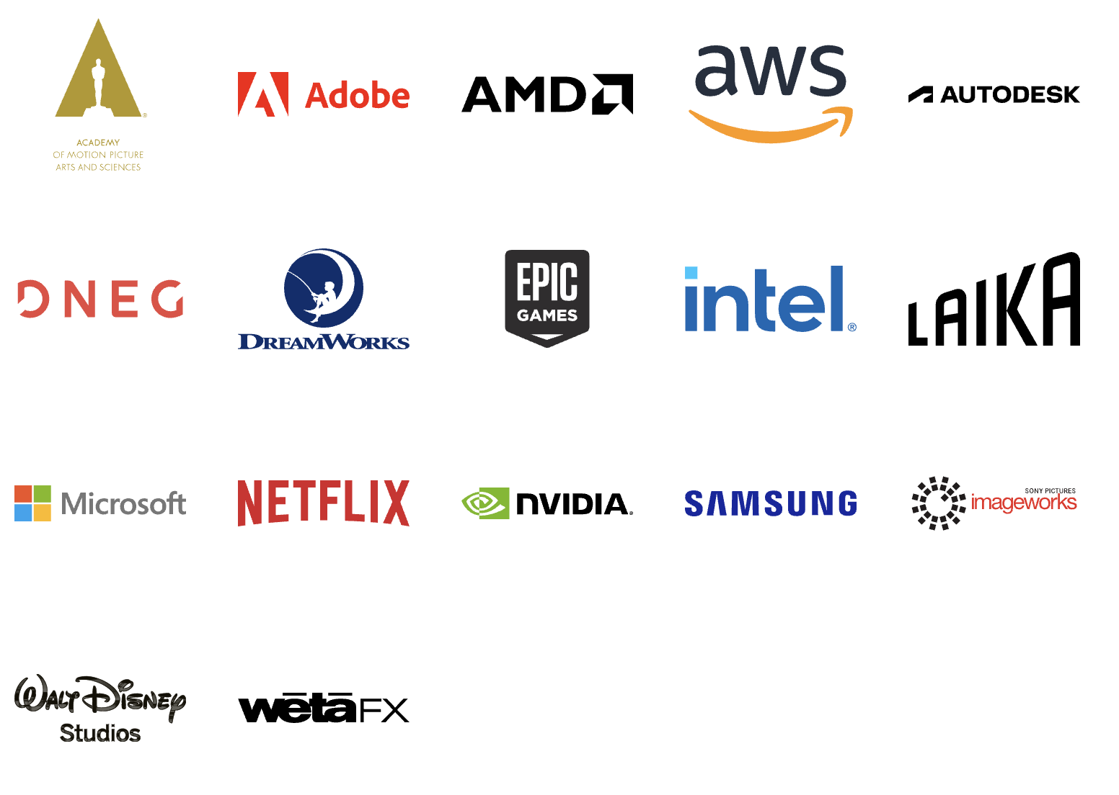
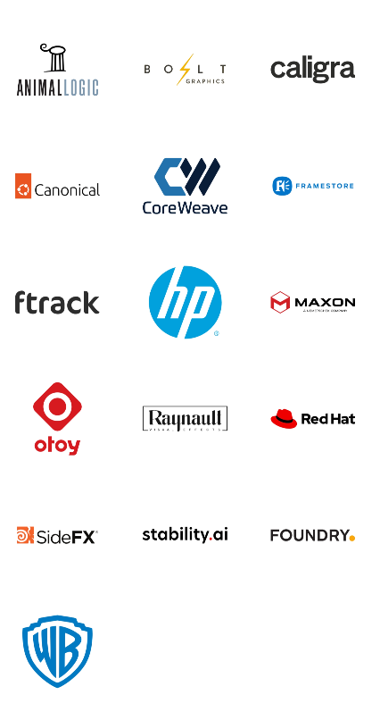
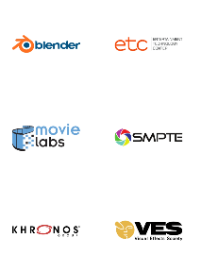
Membership
Premier
General
Associate
Notes:
Source: https://landscape.aswf.io/embed/embed.html?base-path=&key=aswf-member-company&headers=true&category-header=false&category-in-subcategory=false&title-uppercase=false&title-alignment=left&title-font-family=sans-serif&title-font-size=13&style=clean&bg-color=%232b8ca0&fg-color=%23ffffff&item-modal=false&item-name=false&size=lg&items-alignment=left

Slide 7
Our Mission
Increase the quality and quantity of open source contributions by establishing a governance model, a legal framework and a community infrastructure that lowers the barrier to entry for developing and using open source software.

Slide 8
Our Goals
Provide a neutral forum to coordinate cross-project efforts, establish best practices and share resources.
Develop an open continuous integration (CI) and build infrastructure to enable reference builds from the community.
Streamline development for build and runtime environments through the sharing of open source build configurations, scripts and recipes.
Provide individuals and organizations with a clear path for participation and code contribution.
Provide better, more consistent licensing through a shared licensing template.
Create working groups for exploration of new or larger projects.
Focus on diversity and inclusion and raising the profile of software engineers in our industry.

Slide 9
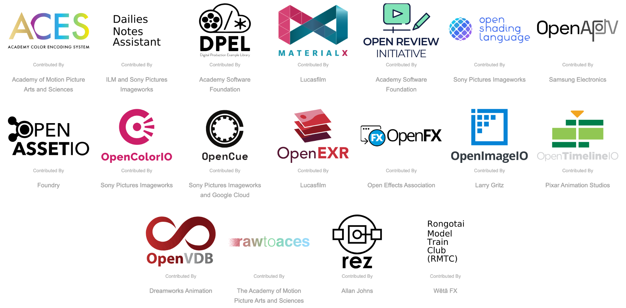
Our Projects
Notes:
Source: https://tac.aswf.io/projects_with_contributed_by

Slide 10

Diversity & Inclusion
“Open source has the power to break down racial, gender, and corporate barriers to unite people around a shared goal…”
Read more at aswf.io/diversity_inclusion

Slide 11
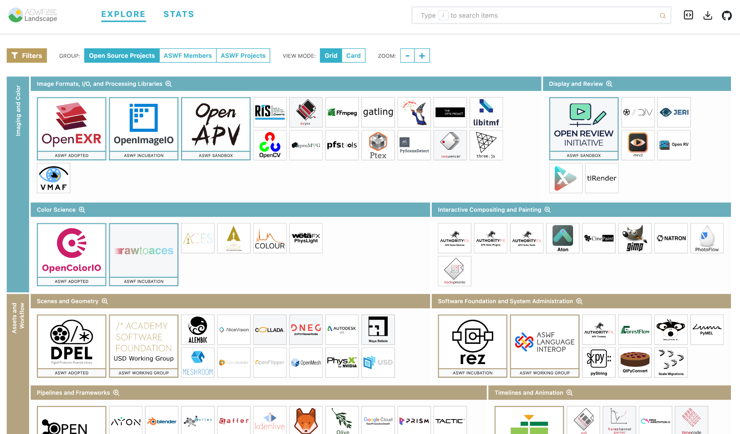
ASWF Landscape
l.aswf.io
Public list of open source projects in the animation and VFX industry
Updates can be submitted via GitHub
Goal is to have all active, open source projects in animation and VFX industries represented.
Notes:
Source: https://landscape.aswf.io/screenshot

Slide 12

















Academy Software Foundation
Structure
TAC
Technical Advisory Council
Governing Board
Outreach Committee
RMTC
DNA
rawtoaces
Continuous Integration platform

Slide 13
Governing Board
Comprised of one voting representative from each Premier Academy Software Foundation member, 1 annually elected General member representative per 5 General members, the TAC Chairperson, and attended by the Outreach Committee Chair, the Governing Board’s responsibilities include:
Approving and managing budget and financial matters
Electing a Chair to preside over Governing Board meetings, authorize expenditures approved by the budget and manage any day-to-day operations
Overseeing all Project business and marketing matters
Meets monthly on the fourth Thursday from 2:00 PM to 3:00 PM US Pacific Time.
Notes:
Only for Premier members

Slide 14
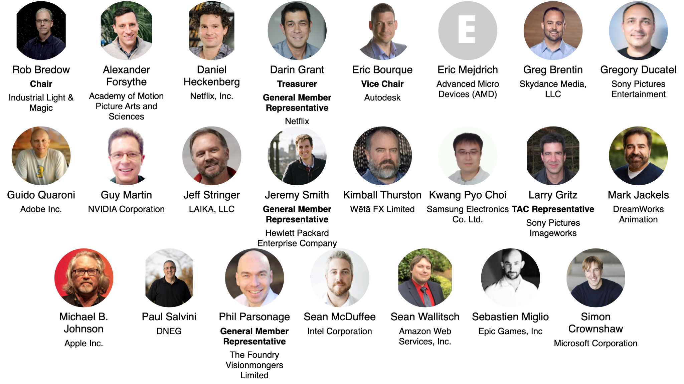
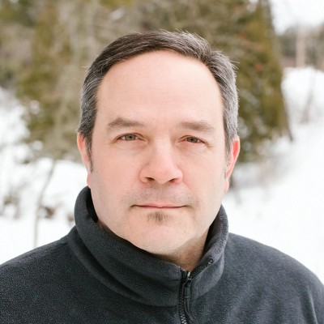
Governing Board Representatives
Notes:
https://jmertic.github.io/committee-gallery/academy-software-foundation-governing-board

Slide 15
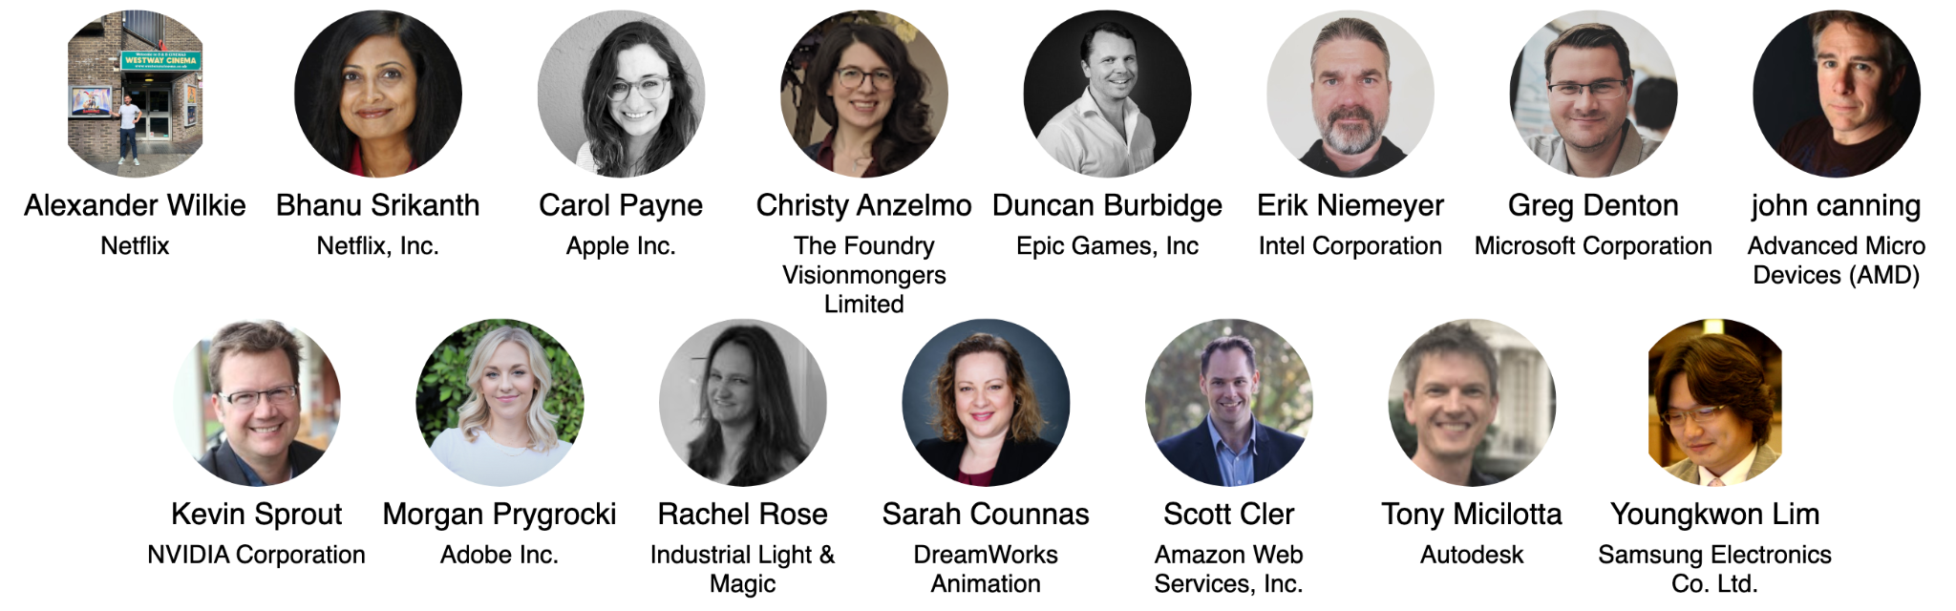
Governing Board Alternates
Notes:
https://jmertic.github.io/committee-gallery/academy-software-foundation-governing-board_slidedeck_alternates

Slide 16
Appointing your Governing Board representative and alternate
(Premier Members only)
As a Premier Member, you are entitled to appoint a representative and an alternate from your organization to serve on the Governing Board. Expectations of this include..
Attending monthly Governing Board meetings ( generally 4th Tuesday of the month at 2:00pm US Pacific Time )
Participation in membership recruitment activities.
Availability for time-to-time for strategic discussions and calls.
ACTION: To appoint your representative and your alternate, please file a request at members.aswf.io, and have the representatives create an LF ID.
You can change your representative at any time by making a request at members.aswf.io.

Slide 17
General Member Governing Board representative
(General Members only)
Per the Academy Software Foundation charter, Section 2(c):
General Members, acting as a class, will be entitled to annually elect one representative to the Governing Board for every five General Members, up to a maximum of three representatives, provided that there will always be at least one General Member representative, even if there are less than five General Members. The Governing Board determines the election process.
The General Member class elects new representative(s) during the month of December to serve a term from January 1st through December 31st of that calendar year.
ACTION: Look for details regarding the election in November. Election process defined here.
If you have any questions about this process or the role, please contact us at members.aswf.io.

Slide 18
Technical Advisory Council (TAC)
The Technical Advisory Council (TAC) is the technical governance heart and soul of the project. As new projects get contributed to the project they get reviewed and approved by this committee.
TAC voting members consist of Premier Academy Software Foundation members as well as the project leads for all Graduated stage projects. Anyone in the community can attend TAC meetings.
Meets every other Wednesday from 1:00 PM to 2:00 PM US Pacific Time.
All are invited to attend these calls - head to tac.aswf.io/meetings for more information and meeting invites.

Slide 19
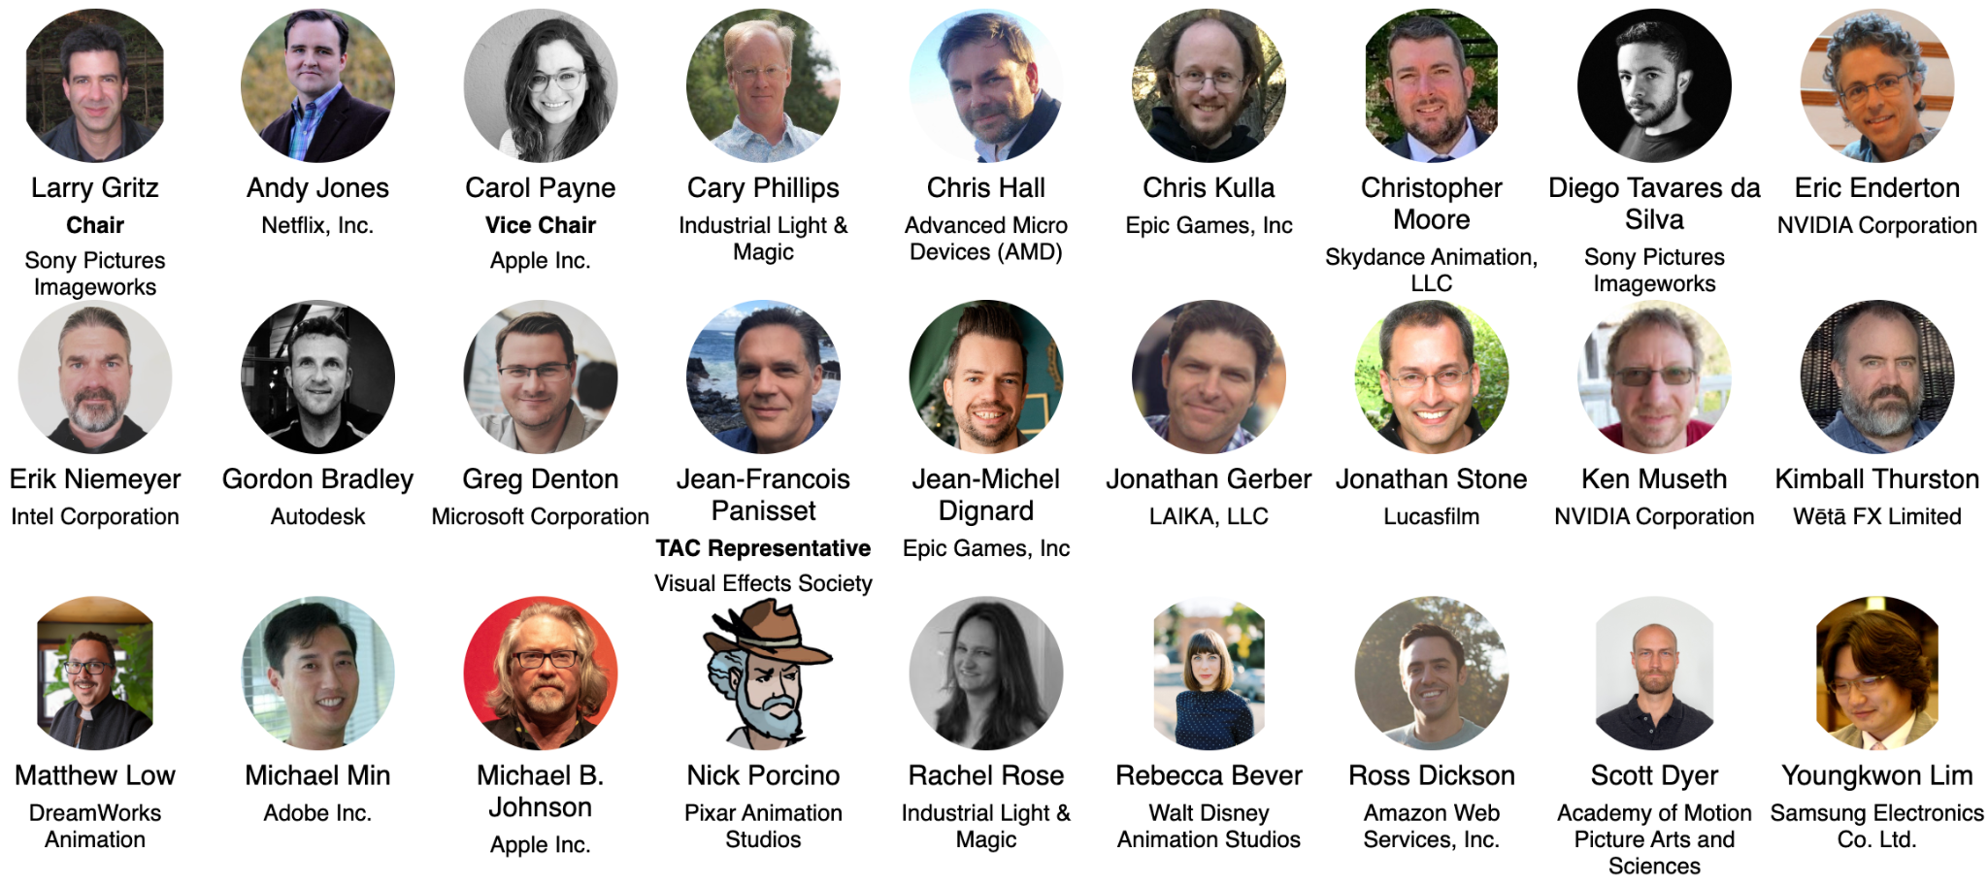
Technical Advisory Council (TAC)
Notes:
https://jmertic.github.io/committee-gallery/academy-software-foundation-tac

Slide 20
Appointing your TAC representative
(Premier Members only)
As a Premier Member, you are entitled to appoint a representative from your organization to serve on the TAC. Expectations of this role include:
Attending TAC meetings held every other week on Wednesday at 1:00 pm US Pacific Time.
Serving as a TAC mentor to a new project coming into the Academy Software Foundation.
Participation in out of meeting discussions.
Availability from time-to-time for strategic discussions and calls.
ACTION: To appoint your representative, please file a request at members.aswf.io, and have the representative create an LF ID.
You can change your representative at any time by making a request at members.aswf.io.

Slide 21
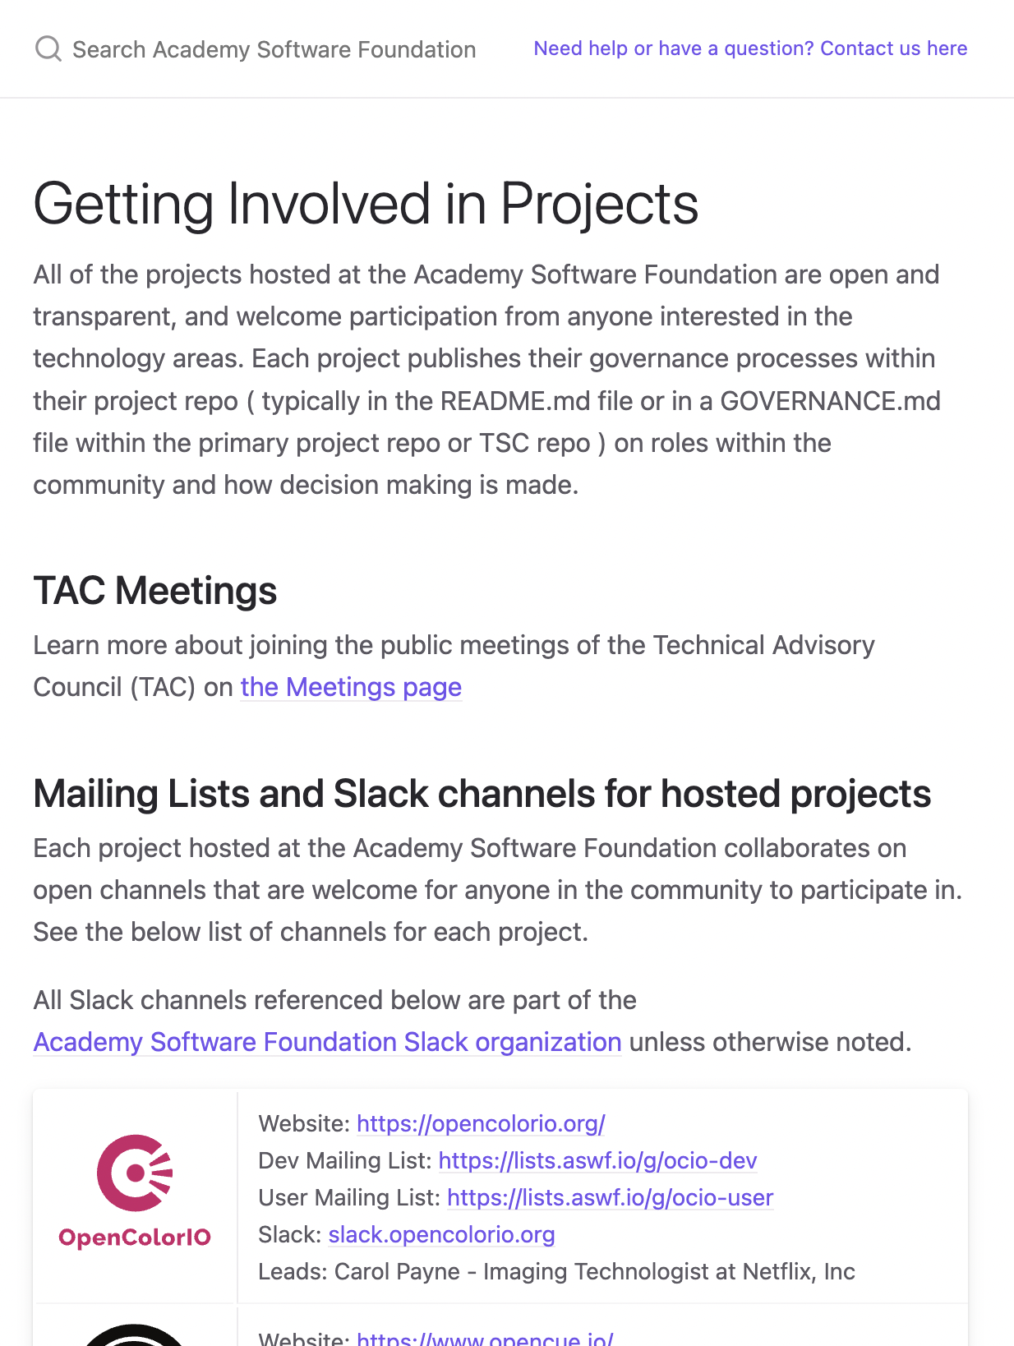
How to contribute to projects
Contribute to an existing project:
Submit a PR with a bugfix or new feature
Pick existing GitHub issue as a sample project
Integrate with a new app / contribute plugin
Help improve project documentation
Submit additional test cases
Join the TSC discussion: dev mailing list, conf calls
Get involved with the TAC or Working Group:
DevOps / CI expertise always useful
Interest / expertise in security especially welcome
Join the TAC discussions: mailing list, conf calls, working groups
More information at tac.aswf.io/engagement

Slide 22
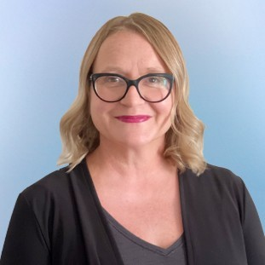
Outreach Committee
The Academy Software Foundation Outreach Committee is open to all Academy Software Foundation members and is charged with defining and executing the marketing and outreach strategy.
Voting members of the Outreach Committee consist of one representative from each Premier member. Any member is welcome to attend and participate in the discussions and work.
Meets monthly on the third Thursday, 1:00 PM to 1:30 PM US Pacific Time
All are invited to attend these calls and encouraged to join the Outreach Committee mailing list for more information
lists.aswf.io/g/outreach
Add Monthly Marketing Meeting to your Calendar Now.
Jen Goldfinch
Outreach Committee Chairperson
Senior Director of Industry Marketing, Foundry

Slide 23


Annual, by-invitation event that gathers business and technical leaders to shape the future of open source software across the motion picture and media industries.
opensourceforum.aswf.io
February 13, 2025
Los Angeles, CA + Virtual
2026 Date To Be Announced
Annual developer focused event showcasing the latest from Academy Software Foundation projects along with other open source projects used for visual effects, animation, and image creation.
opensourceforum.aswf.io
August 10, 2025
Vancouver, Canada + Virtual

Slide 24
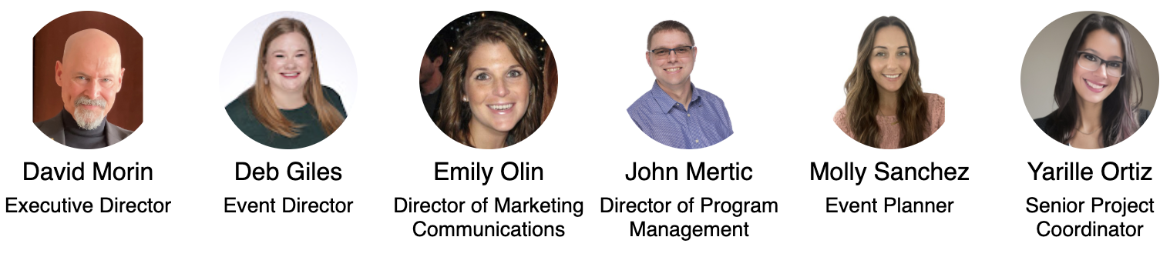
Foundation Staff
Contact the staff at members.aswf.io
Notes:
https://jmertic.github.io/committee-gallery/academy-software-foundation-staff_slidedeck_all

Slide 25
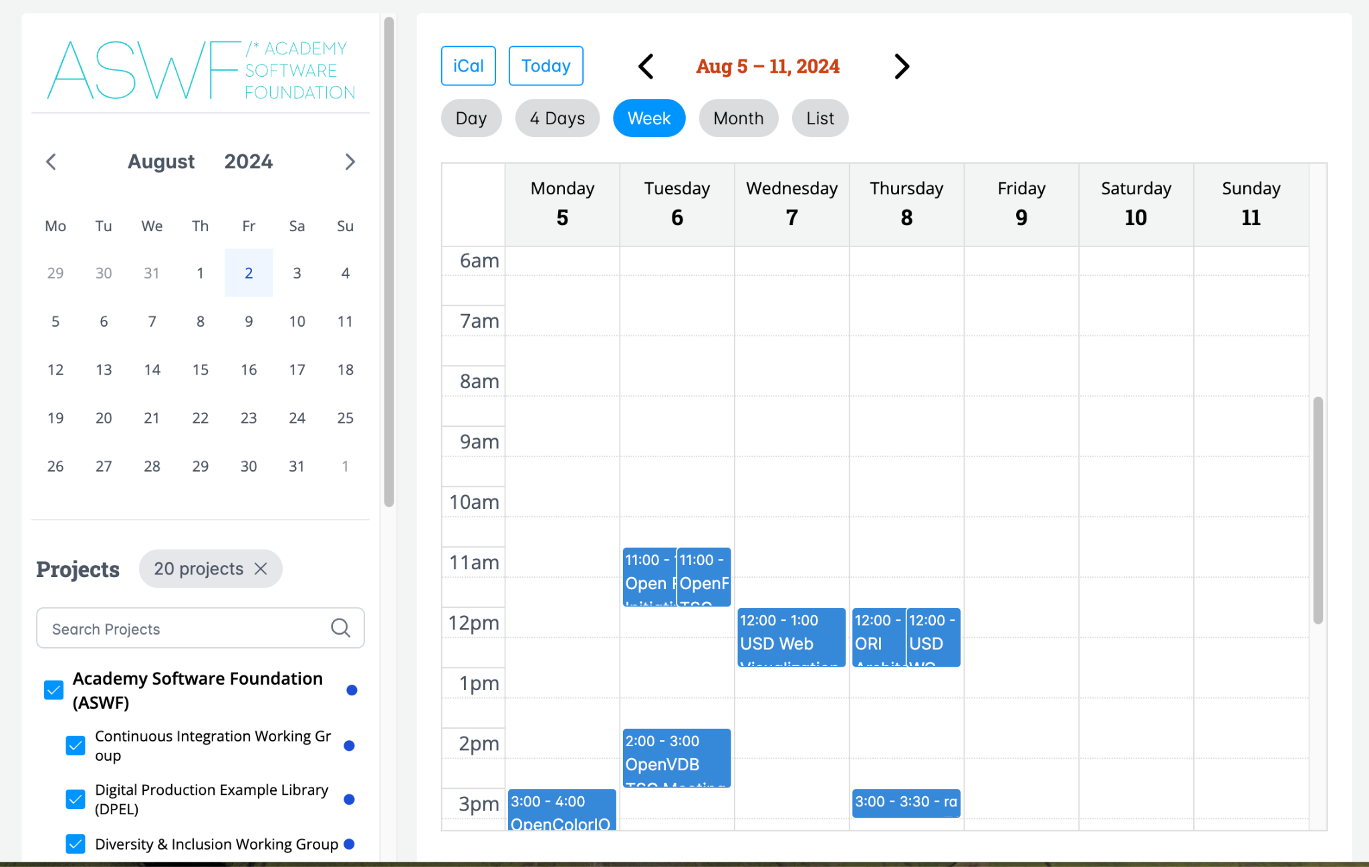
Keeping the meetings on your calendar
Always find the latest public ASWF meetings on the official calendar at calendar.aswf.io.
You can always find meetings you’ve registered to attend in your LF profile calendar.

Slide 26
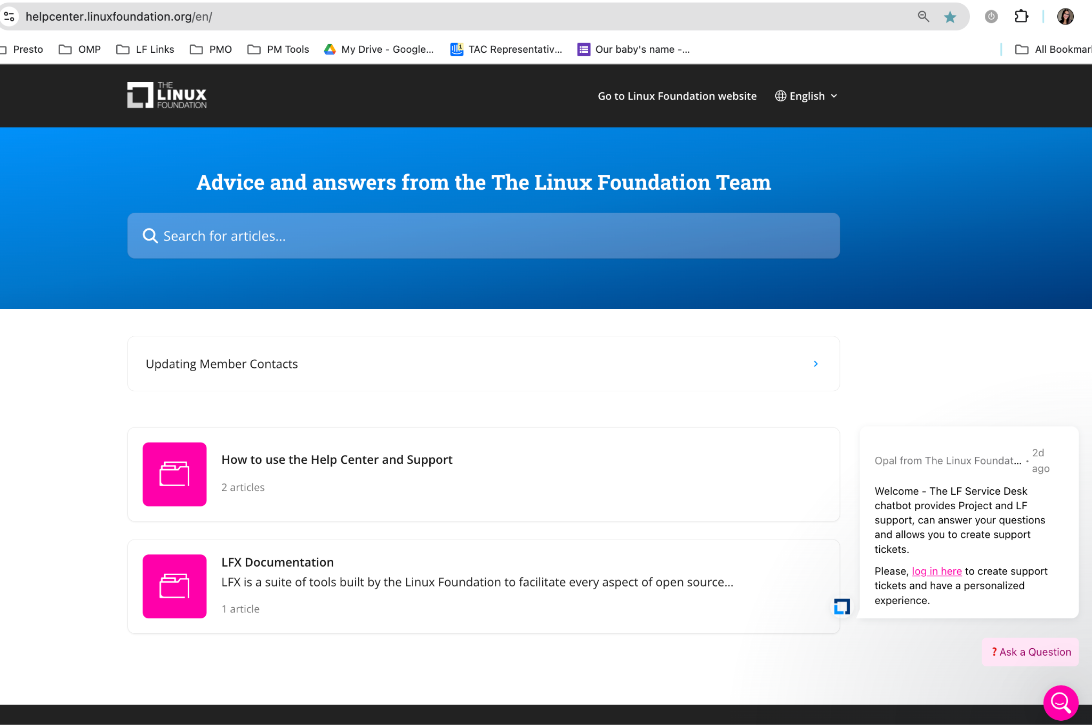
Member Help Center
Linux Foundation has centralized many PMO operational functions into a centralized help center to improve efficiency and ensure optimal response times. The Help Center has a new look. Check it out: members.aswf.io
Use this for:
Billing/Invoice questions
Membership benefits
Contact changes
Helping to get engaged in projects or opportunities.
*Featuring a chat agent*

Slide 27

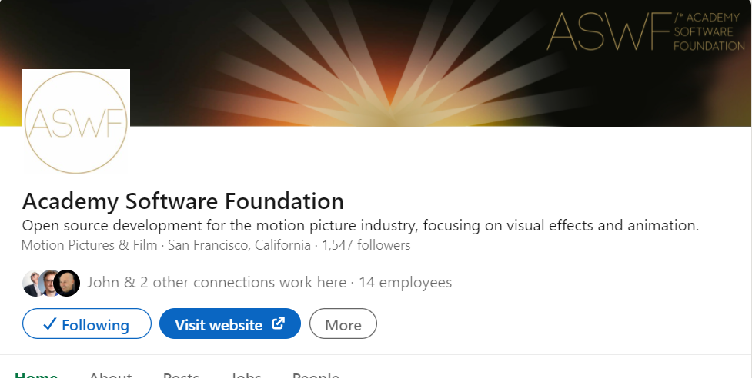
Follow us on social
Follow us on Twitter at
https://twitter.com/AcademySwf
Follow us on LinkedIn at https://www.linkedin.com/company/academysoftwarefoundation/

Slide 28
Leveraging your membership benefits

Slide 29
LFX Organization Dashboard
LFX Organization Dashboard provides access to key membership materials, including…
Member contacts, which you can change at any time ( look under ‘Users’ > and then under the ‘Key People’ tab )
Membership details ( look under ‘Membership’ > ‘Academy Software Foundation’ ), including…
Membership Overview Deck and High Level Overview Deck ( look under the ‘Resources’ tab )
Your fully executed membership agreement ( look under under the ‘Membership’ tab )
Details on how to leverage membership benefits ( look under the ‘Benefits’ tab )
Insights on contributors from your organization ( look under the ‘Project Contributors’ tab )
ACTION: Request access to LFX Organizational Dashboard here.

Slide 30
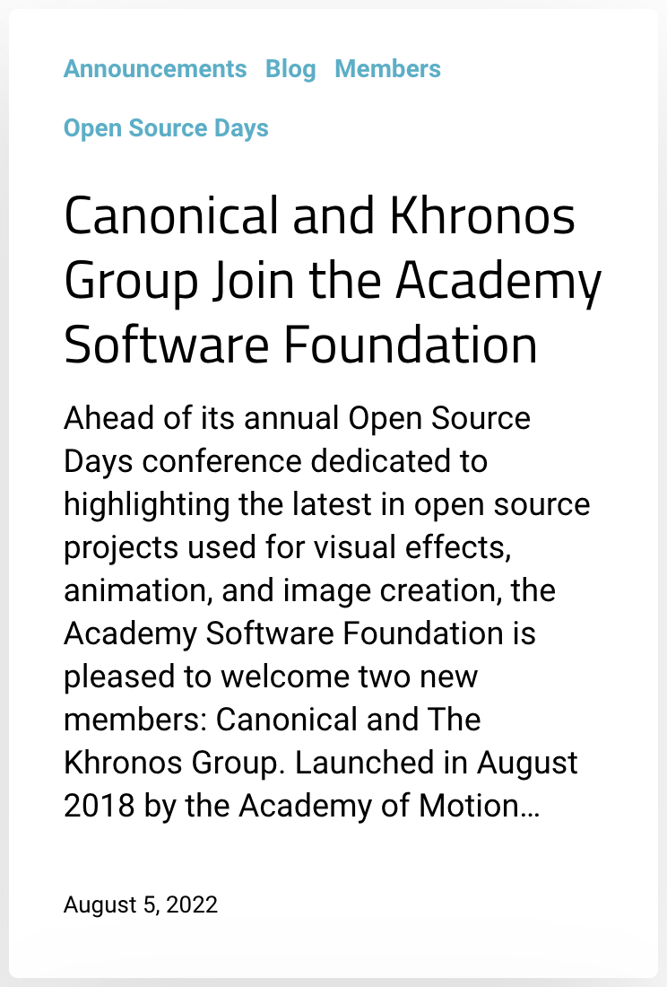
Announcing your membership
We will include your company in an upcoming momentum press announcement. These are typically done quarterly and timed around events for maximum impact.
ACTION: Please provide 1-2 sentences on your company, name of a spokesperson, and a quote to include in the press announcement. Submit request to members.aswf.io.
Please note that these announcements are often picked up by press and media, and there may be requests for briefings.

Slide 31


Participate in Outreach Activities
We focus on ensuring our members can advance their thought leadership on open source in the visual and special effects industry through our extensive media reach.
ACTION: Key opportunities to leverage now:
Submit a guest blog post to the Academy Software Foundation blog and/or Linux.com. Member contributed content must be vendor neutral & talk about an interesting trend or problem in the space.
Nominate one of your employees to be profiled in a “Behind the Scenes” interview. In Behind the Screens, we talk to developers and software engineers from across the motion picture and media industries to learn more about their work in visual effects and animation, how they use open source software, and their involvement in the Academy Software Foundation.
Share potential spokespersons who would be interested in participating in other contributed articles, videos, podcasts, and events.
Share your news pertaining to one of our projects or your work in the open source on mainframe community for us to amplify and/or offer a quote.
Share events you will be at so we can promote your presence and talks relating to Academy Software Foundation.
2000+
followers
1800+
followers

Slide 32


Academy Software Foundation and
The Linux Foundation Logos
Download Logos
Contact trademark@linuxfoundation.org with any questions. Please review our brand trademark policy here.

Slide 33
THANK YOU!

